Slide 1

SOUTH-SOUTH MIGRATION: WHAT IS at ISSUE?
Jonathan Crush, Balsillie School of International Affairs
Abel Chikanda, University of Kansas

Slide 2
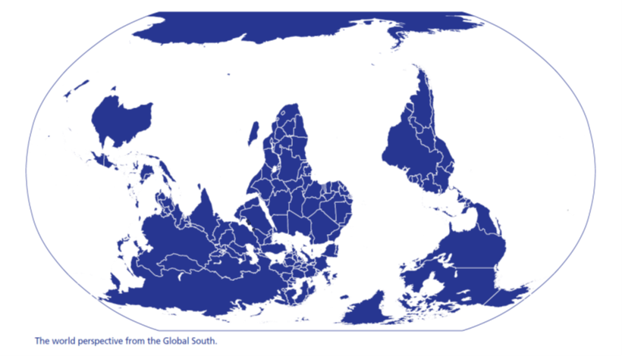
FOUNDATIONAL ISSUES
Directions
Difference
Definitions
Disaggregation
Differentiation
Delinking

Slide 3
DIrections
What are the drivers of South-South migration and what forms does it take?
How do states respond to South-South migration in terms of management, policy and practice - regional, national and municipal?
What about South-South migrant employment conditions, precarity, self-employment in informal sector, livelihoods in cities and corridors?
How do citizens respond to the presence and activities of migrants? Why is xenophobia on the rise in the Global South?
What kinds of material and other linkages do South-South migrants maintain with countries, communities and households?
What do we currently know about South-South migration movements and how do they differ from/connect with South-North movements?
How are South-South migration and food security connected? Is food insecurity a driver of migration and does migration lead to better or worse food security outcomes?
What are the connections between internal and international South-South migrations?

Slide 4

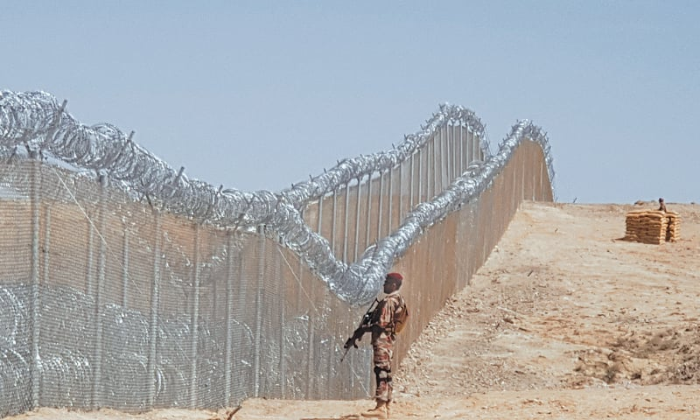
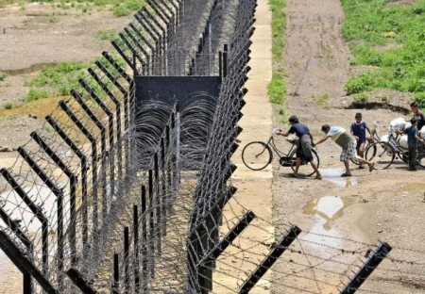
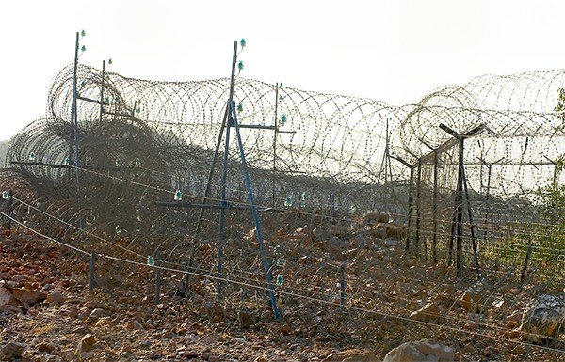
MEXICO-USA
PAKISTAN-AFGHANISTAN
INDIA-BANGLADESH
SOUTH AFRICA-ZIMBABWE

Slide 5
DIFFERENCE
South-South migration is an increasingly significant factor in the economic and social development of many developing countries. This type of migration differs from migration to OECD countries in important ways (OECD 2019)
Although South-South migrants face much of the same resentment from the locally born over jobs and wages as their South-North counterparts, the issues in South-South flows need to be analysed from a quite different standpoint (Gagnon and Khoudour-Castéras 2011)
Migrants who travel to other developing countries enjoy much lower increases in income, are more likely to be irregular, are subject to greater risks of exploitation, and are more likely to be expelled than are those who migrate from developing countries to industrial countries (Ratha and Shaw 2007).
Most studies fail to clarify what is different about South-South migration and why we should pay attention to it. Arguments are good for why it may be similar or different to what we’ve come to expect from previously studied migration corridors. But there are also many misconceptions about South-South migration (Gagnon 2018)

Slide 6
definitionS

Slide 7
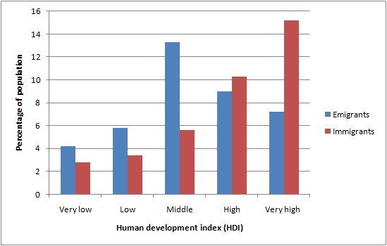
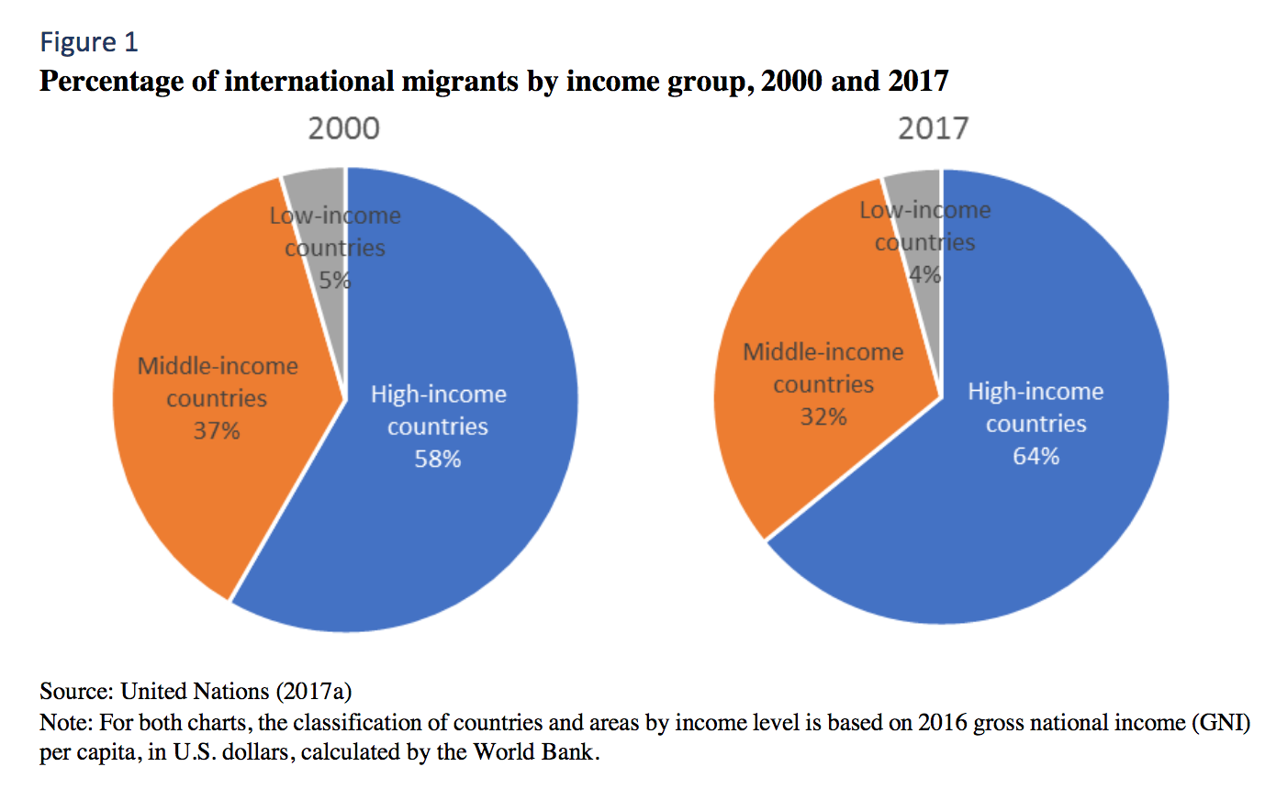

Slide 8
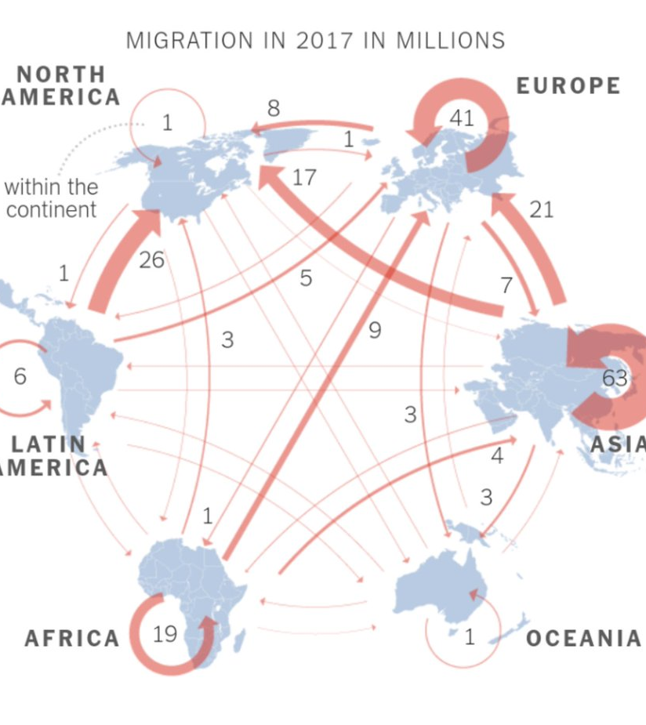
Disaggregation - DISTANCE
Most South-South Migration is intra-regional (and between neighbours)

Slide 9
DISaggregation - dimensions
Analysis of the UN Migration Data Base (Crush and Chikanda, 2018) shows that the vast majority of countries in South are involved as origins (161) or destinations (158) BUT the number of countries with large migrant populations (both origin and destination) is relatively small. As the migrant populations decline so the number of countries involved increases

Slide 10
DISAGGREGATION - DISPERSAL
Major sending countries have migrants in numerous destination countries.
Major destination countries draw migrants from numerous other countries

Slide 11
DISAGGREGATION - DIRECTIONALITY
Despite the wide dispersal of South-South migrants, there are distinctive bilateral migration corridors

Slide 12
Differentiation
Hugo (2009)

Slide 13
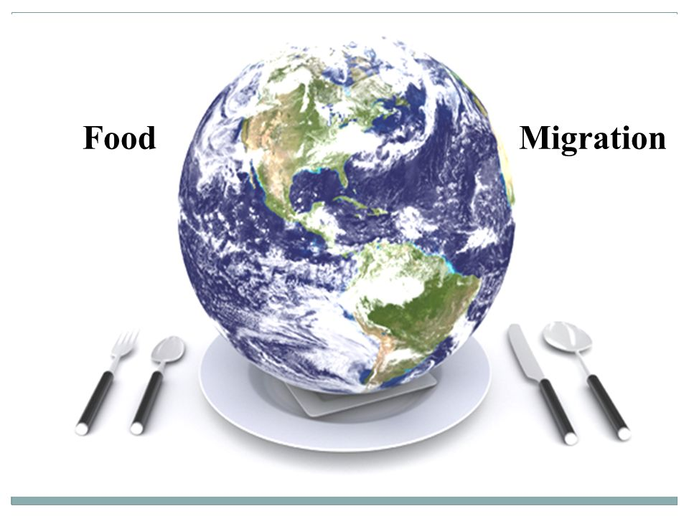


DELINKING
1. Migration and food security have separate global governance and research agendas. The links between migration and food security are largely ignored in the literature and in agendas such as the SDGs, the Global Compacts, the GFMD, World Committee on Food Security etc.
2. There is a danger that the delinking of migration from food security will be reproduced in emerging work on South-South migration. One of the aims of this workshop is to explore some of these links and to advocate for closer attention to them in policy and research agendas.
3. Currently, in the world of food security policy and research, it is as if no-one ever moves. Likewise, in the world of migration policy and research, it is as if no-one ever eats anything.

